Slide 1

MATRIX MANIPULATOR
PRESENTED BY:
PRERNA BHARTI – 1641012048 NIKHIL RANJAN NAYAK - 1641012040
SATYASMITH RAY – 1641012108 BAIBHAV SWAIN - 1641012206
SONU BINAY – 1641012316
(CSE ‘F’ 4th SEMESTER)

Slide 2
Problem Statement
To develop matrix operation calculator using MIPS.
It consists of basic operation like addition, subtraction, scaling and transpose and multiplication.
Addition or subtraction is accomplished by adding or subtracting corresponding elements.
Scaling is used to scale up/down the matrix with a constant using scalar multiplication.
Transpose of matrix is that in which all the rows of a given matrix is transformed into columns and vice-versa.
Multiplication of matrices is also done using MIPS code by rows of first matrix with the columns of second matrix.
The determinant of a matrix is a scalar property of that matrix, which can be thought of physically as the volume enclosed by the row vectors of the matrix. Only square matrices have determinants.

Slide 3
Brief Description
Manipulator system will be required to carry out various operations and provide meaning to these combined structures.
In Matrix Addition and subtraction, we assume the two matrices given in the data segment. All we have to do is to start with the base address, add the respective elements of the two matrices, increment the address by four and do the same till the length is reached.
While approaching for the Scaling of matrices there are many prospects to show scaling. We chose the one with scalar multiplication of the matrix with a constant.
The next operation assigned to us is transpose in which we just have to reverse the rows with the columns and the columns with the rows simultaneously.
To find determinant we use the formula A[0][0] x ((A[1][1]xA[2][2])-(A[2][1]xA[1][2]))-A[0][1]x((A[1][0]xA[2][2])-(A[2][0]xA[1][2]))+A[0][2]x((A[1][0]xA[2][1])-(A[2][0]xA[1][1])) as we have considered a 3x3 squared matrix.
The last operation is multiplication of the matrix which is done multiplying the rows of first matrix with the columns of second matrix.
If the user enters invalid option then error message is displayed.

Slide 4
Algorithm
Step 1. Input the two matrixes each of size 3x3 from the user in the console using various syscall services.
Step 2. Prompt the user to enter the choice of the operation and store it in $t0 register.
Step 3.
If the content of $t0 register=1 then perform addition of the two matrices (using addition function).
Else If the content of $t0 register=2 then perform subtraction of the two matrices (using subtraction function).
Else If the content of $t0 register=3 then perform multiplication of two matrices (using multiplication function).
Else If the content of $t0 register=4 then perform transpose of first matrix (using transpose function).
Else If the content of $t0 register= 5 then find determinant of first matrix (using determinant function).
Else If the content of $t0 register= 6 then perform scaling for first matrix by taking a scaling element(using scaling function).
Else If the content of $t0 register= 7 then exit.
Else For any other choice, display the error message.

Slide 5
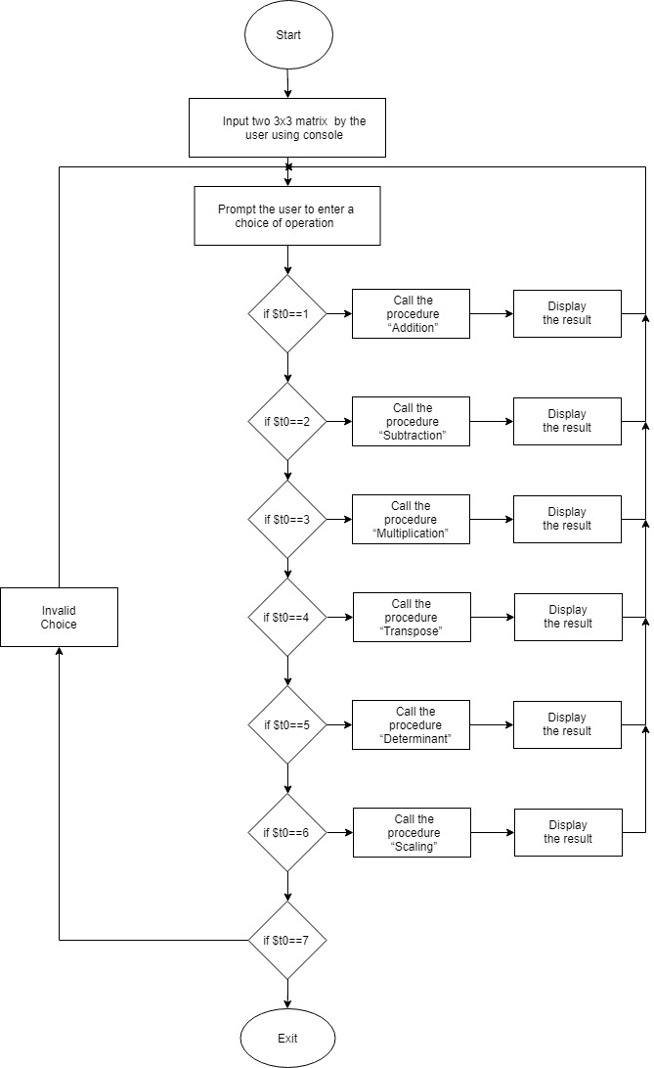
Flow Chart

Slide 6
C Implementation
#include<stdio.h>
void addition(int A[][3],int B[][3],int n);
void subtraction(int A[][3],int B[][3],int n);
void multiplication(int A[][3],int B[][3],int n);
void transpose(int A[][3],int n);
void determinant(int A[][3]);
void scaling(int A[][3],int n);
void print_matrix(int A[][3],int n);
int main()
{
int n,i,j,choice;
printf("Enter dimension of array=> ");
scanf("%d",&n);
int A[3][3],B[3][3];
printf("Enter elements in first array\n");
for(i=0;i<n;i++){
for(j=0;j<n;j++){

Slide 7
for(j=0;j<n;j++){
scanf("%d",&A[i][j]);
}
}
printf("Enter elements in second array\n");
for(i=0;i<n;i++){
for(j=0;j<n;j++){
scanf("%d",&B[i][j]);
}
}
printf("\nFirst entered matrix is as follows:\n");
print_matrix(A,n);
printf("\nSecond entered matrix is as follows:\n");
print_matrix(B,n);
printf("\nMENU\n");
printf("1.ADDITION\n");
printf("2.SUBTRACTION\n");
printf("3.MULTIPLICATION\n");
printf("4.TRANSPOSE\n");
printf("5.DETERMINANT\n");
printf("6.SCALING\n");

Slide 8
printf("7.EXIT\n");
printf("Enter your choice=> ");
scanf("%d",&choice);
while(choice!=7){
switch(choice){
case 1:
addition(A,B,n);
break;
case 2:
subtraction(A,B,n);
break;
case 3:
multiplication(A,B,n);
break;
case 4:
transpose(A,n);
break;
case 5:
determinant(A);
break;

Slide 9
case 6:
scaling(A,n);
break;
default:
printf("\nINVALID CHOICE!");
}
printf("\nEnter your choice=> ");
scanf("%d",&choice);
}
printf("\nEXITING");
return 0;
}
void addition(int A[][3],int B[][3],int n)
{
int i,j,sum=0;
printf("\nResultant matrix:\n");
for(i=0;i<n;i++){
for(j=0;j<n;j++){
sum=A[i][j]+B[i][j];
printf("%d ",sum);
}
printf("\n");
}
}

Slide 10
void subtraction(int A[][3],int B[][3],int n)
{
printf("\nResultant matrix:\n");
int i,j,diff=0;
for(i=0;i<n;i++){
for(j=0;j<n;j++){
diff=A[i][j]-B[i][j];
printf("%d ",diff);
}
printf("\n");
}
}
void multiplication(int A[][3],int B[][3],int n)
{
int i,j,k,sum;
printf("\nResultant matrix:\n");
for(i=0;i<n;i++){
for(j=0;j<n;j++){
sum=0;
for(k=0;k<n;k++){
sum+=A[i][k]*B[k][j];
}
printf("%d ",sum);
}

Slide 11
}
printf("\n");
}
}
void transpose(int A[][3],int n)
{
int i,j,t;
printf("\nResultant matrix:\n");
for(i=0;i<n;i++){
for(j=0;j<n;j++){
t=A[j][i];
printf("%d ",t);
}
printf("\n");
}
}
void determinant(int A[][3])
{
int d=A[0][0]*((A[1][1]*A[2][2])-(A[2][1]*A[1][2]))-A[0][1]*((A[1][0]*A[2][2])-(A[2][0]*A[1][2]))+A[0][2]*((A[1][0]*A[2][1])-(A[2][0]*A[1][1]));
printf("\nDeterminant result= %d",d);
}
void scaling(int A[][3],int n)

Slide 12
{
int scaling_factor,scale,i,j;
printf("Enter a number for performing scaling=> ");
scanf("%d",&scaling_factor);
printf("\nResultant matrix:\n");
for(i=0;i<n;i++){
for(j=0;j<n;j++){
scale=A[i][j]*scaling_factor;
printf("%d ",scale);
}
printf("\n");
}
}
void print_matrix(int A[][3],int n)
{
int i,j;
for(i=0;i<n;i++){
for(j=0;j<n;j++){
printf("%d ",A[i][j]);
}
printf("\n");
}
}

Slide 13
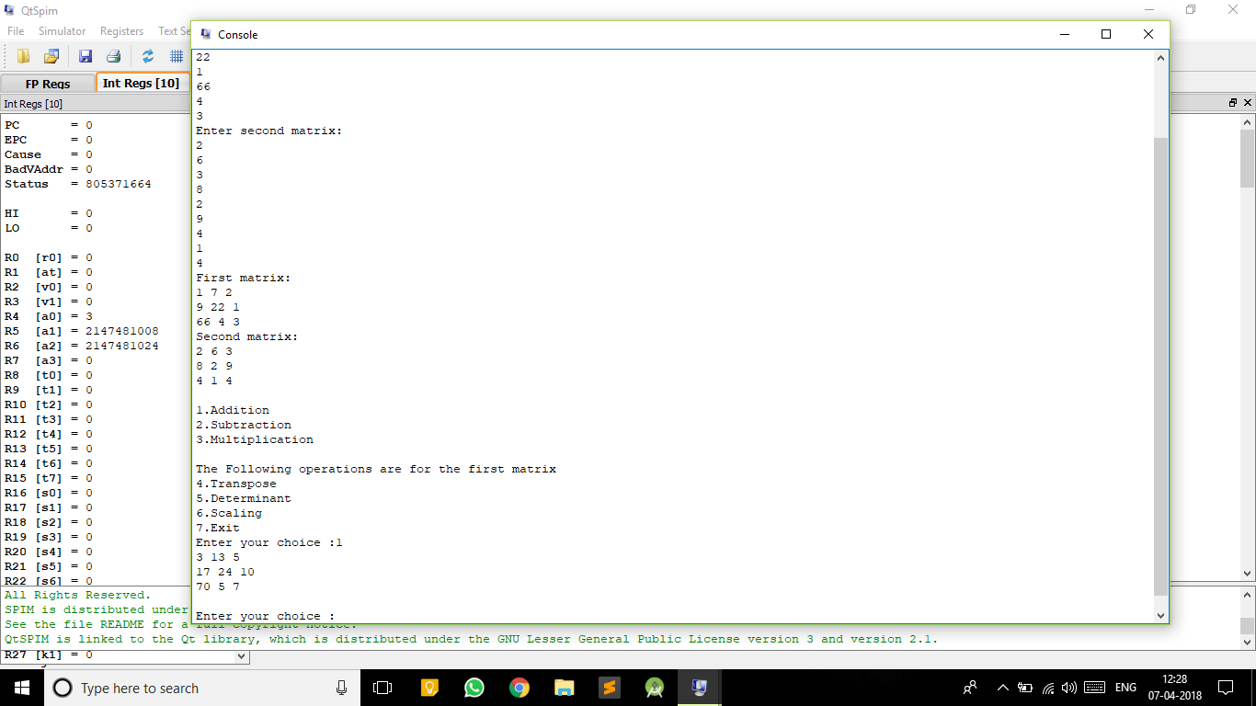
Screenshots
ADDITION

Slide 14
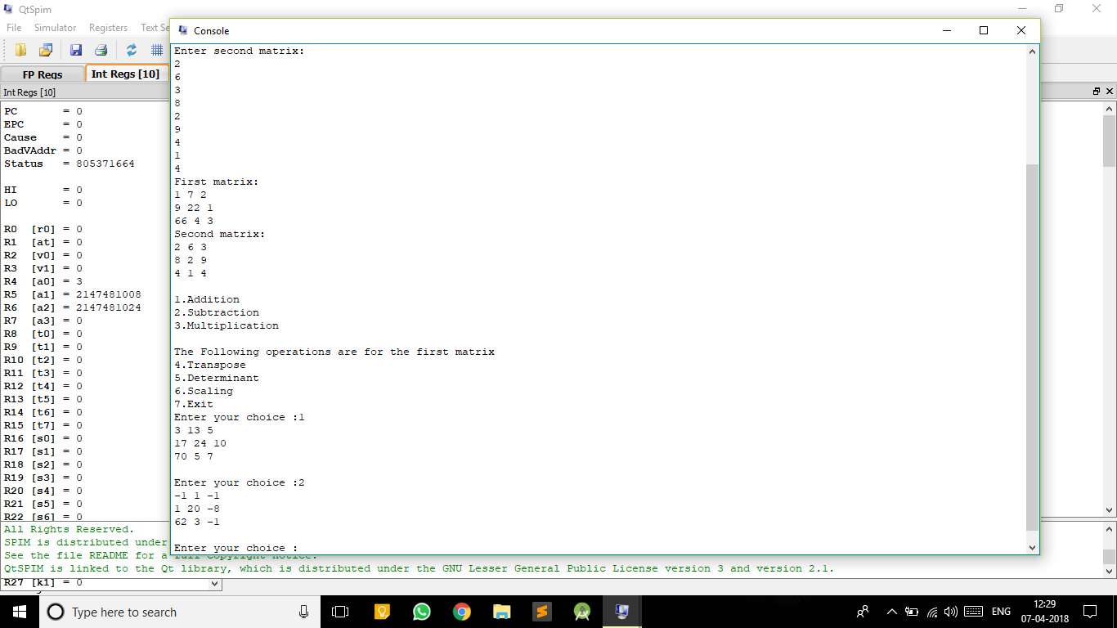
SUBTRACTION

Slide 15

MULTIPLICATION

Slide 16
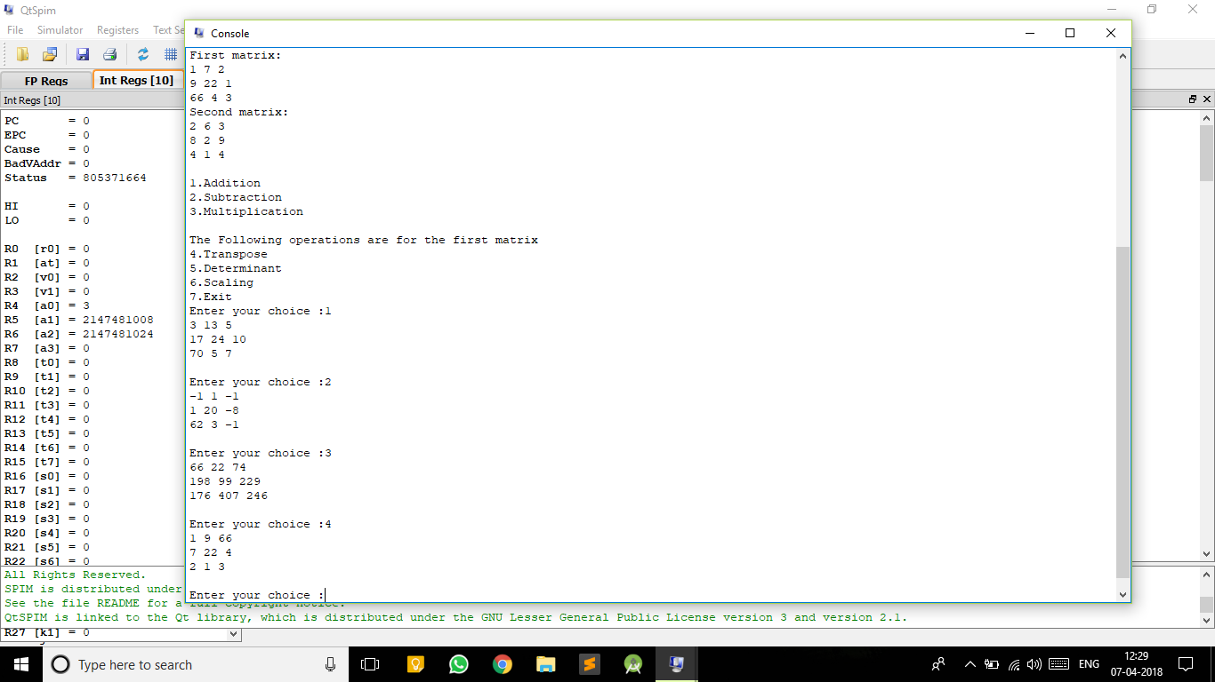
TRANSPOSE

Slide 17
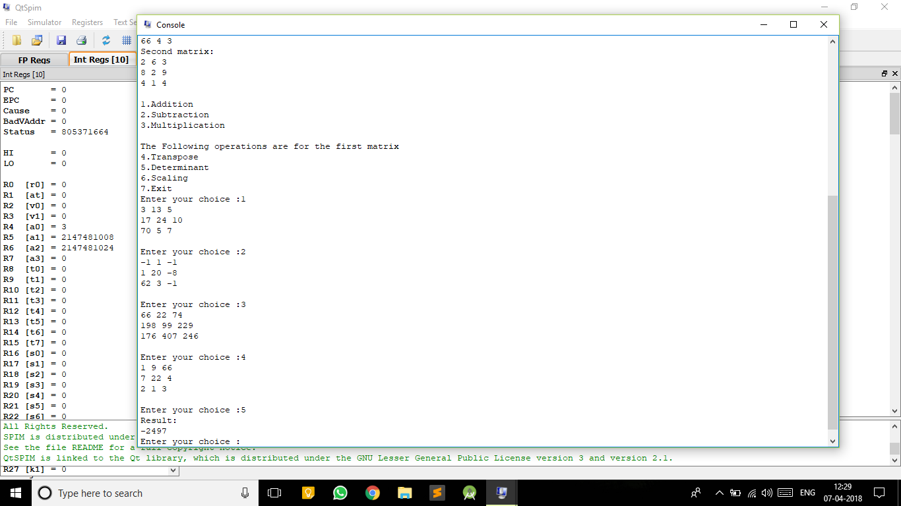
DETERMINANT

Slide 18
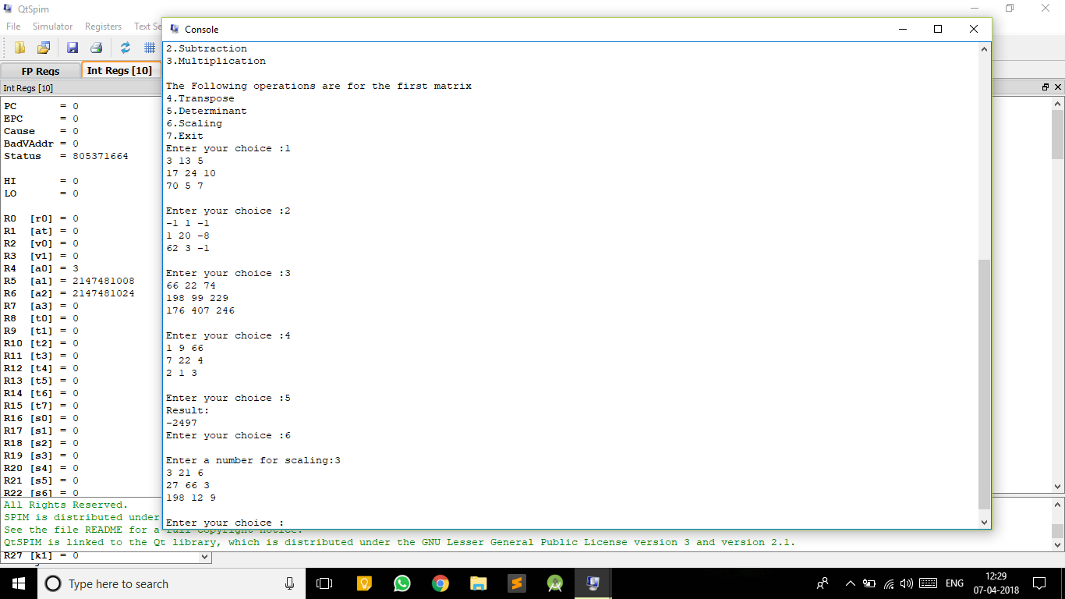
SCALING

Slide 19
Conclusion
From this project, we got an idea on how to perform different arithmetic operations on matrix like addition, subtraction, multiplication, transpose, determinant and scaling using MIPS code.

Slide 20
References
Computer Organization and Design
By David A Patterson and John L Hennessy.
New Jersey Institute of Technology eLab
http://ecelabs.njit.edu/ece459/lab1.php
University of Pittsburgh e-Library
http://people.cs.pitt.edu/~xujie/cs447/AccessingArray
Draw.io
Online diagram software for making flowcharts

